Slide 1
Active Data
http://activedata.allizom.org
  Kyle Lahnakoski
  Engineering Productivity
  formerly Auto-Tools Team…
  but still the “A Team”

Slide 2

Lightning talk on…
Active Data
http://activedata.allizom.org
  Kyle Lahnakoski
  Engineering Productivity
  (formerly Auto-Tools Team)
  …but still the “A Team”

Slide 3
What is ActiveData?
A public web service…
$ curl http://activedata.allizom.org/query
-X POST
-d "{\"from\":\"unittest\"}"

Slide 4
What is ActiveData?
A public web service…
providing a query interface…
{
"select":{
"aggregate":"count"
},
"from":"unittest"
}

Slide 5
What is ActiveData?
A public web service…
providing a query interface…
to over a billion test results…
{
"meta":{
"active_data_response_time":3.09,
"format":"cube",
"es_response_time":1.57,
"saved_as":"3iK9T6sG",
"content_type":"application/json"
},
"data":{"count":1265099071}
}

Slide 6
What is ActiveData?
A public web service…
providing a query interface…
to over a billion test results…
Quickly!
{
"meta":{
"active_data_response_time":3.09,
"format":"cube",
"es_response_time":1.57,
"saved_as":"3iK9T6sG",
"content_type":"application/json"
},
"data":{"count":1265099071}
}

Slide 7
Test Result Document
{
"_id": "182553:18220451.14.179",
"result": {
"status": "OK",
"stats": {
"action": {
"test_status": 432
},
"fail": 6,
"pass": 426
},
"ok": false,
"start_time": 1441284018.565,
"test": "toolkit/components/prompts/test/test_modal_prompts.html",
"result": "OK",
"expected": "OK",
"last_log_time": 1441284036.021,
"duration": 17.473999977111816,
"end_time": 1441284036.039,
"subtests": [
{
"status": "fail",
"ok": false,
"name": "checking button0 default",
"ordering": 0,
"timestamp": 1441284033.645,
"subtest": "checking button0 default",
"expected": "pass",
"message": "got false, expected true"
},
{
"status": "fail",
"ok": false,
"name": "checking button0 default",
"ordering": 1,
"timestamp": 1441284034.381,
"subtest": "checking button0 default",
"expected": "pass",
"message": "got false, expected true"
}
]
},
"run": {
"files": {
"url": "http://mozilla-releng-blobs.s3.amazonaws.com/blobs/mozilla-inbound/sha512/e6c834818fbbad050543c7dc5ec7ddc00b2433ea9dcfa0217bd99a3ae40daacfd74c9225a7a8945d5a4e02449af5ffc6452bc7c6a97a49592227cfca11dc1f93",
"name": "plain-chunked_raw.log"
},
"status": 1,
"stats": {
"status": {"skip": 18, "ok": 636},
"ok": 653,
"lines": 3705,
"start_time": 1441283166.06,
"bytes": 869394,
"action": {
"test_status": 617,
"log": 1718,
"process_exit": 30,
"process_start": 30
},
"end_time": 1441284124.884,
"duration": 958.824000120163,
"total": 654
},
"buildbot_status": "warnings",
"timestamp": 1441284143,
"chunk": 5,
"talos": false,
"machine": {
"os": "ubuntu64_vm",
"name": "tst-linux64-spot-1771“
},
"key": "build.mozilla-inbound_ubuntu64_vm_test_pgo-mochitest-5.53.log_uploaded",
"suite": "mochitest",
"insertion_time": 1441284143,
"job_number": 53,
"logurl": "http://ftp.mozilla.org/pub/mozilla.org/firefox/tinderbox-builds/mozilla-inbound-linux64-pgo/1441279802/mozilla-inbound_ubuntu64_vm_test_pgo-mochitest-5-bm122-tests1-linux64-build53.txt.gz"
},
"build": {
"product": "firefox",
"revision12": "550e06c1615f",
"name": "Ubuntu VM 12.04 x64 mozilla-inbound pgo test mochitest-5",
"url": "https://queue.taskcluster.net/v1/task/T6IwwMnmQLWMHAZ3Y2Z9xA/artifacts/public/build/firefox-43.0a1.en-US.linux-x86_64.tar.bz2",
"platform": "linux64",
"branch": "mozilla-inbound",
"date": 1441254602,
"release": "production",
"locale": "en-US",
"type": "pgo",
"id": "20150903043002",
"revision": "550e06c1615f82cc82278873f8137edbdd0c3c3a"
},
"repo": {
"changeset": {
"files": [
"js/src/vm/HelperThreads.cpp",
"js/src/vm/HelperThreads.h",
"js/src/vm/Runtime.cpp"
],
"description": "Bug 1201051 - Make helper thread initialization report errors rather than crashing r=terrence",
"author": "Jon <replaced@mozilla.com>",
"id12": "550e06c1615f",
"date": 1441278480,
"id": "550e06c1615f82cc82278873f8137edbdd0c3c3a"
},
"index": 260643,
"parents": "21e229c5ff708285d9e2c837c9679aab55ee4c48",
"branch": {
"url": "https://hg.mozilla.org/integration/mozilla-inbound",
"last_used": 1440115924,
"locale": "en-US",
"name": "mozilla-inbound",
"parent_name": "Source code integration work"
},
"push": {
"date": 1441278531,
"user": "replaced@mozilla.com",
"id": 64555
},
"children": "e737274a67063f673d47d1895e3008dc6d73cf9c",
"etl": {"timestamp": 1441286446.851573}
},
"etl": {
"name": "unittest",
"timestamp": 1441286777.499345,
"source": {
"os": "Linux3.13.0-48-generic",
"python": "CPython",
"timestamp": 1441286769.820252,
"source": {
"name": "Pulse block",
"timestamp": 1441284205.602198,
"bucket": "ekyle-pulse-logger",
"source": {
"count": 18220475,
"name": "pulse.mozilla.org",
"sent": 1441255343,
"id": 18220475
},
"type": "aggregation",
"id": 182553
},
"type": "join",
"id": 14,
"name": "plain-chunked_raw.log"
},
"duration": 7.638665000000002,
"type": "join",
"id": 179,
"revision": "bed2888f2ba55f32ac8792944c1ca822797cf7e3"
}
}
One test result document

Slide 8
Test Result Document
{
"_id": "182553:18220451.14.179",
"result": {
"status": "OK",
"stats": {
"action": {
"test_status": 432
},
"fail": 6,
"pass": 426
},
"ok": false,
"start_time": 1441284018.565,
"test": "toolkit/components/prompts/test/test_modal_prompts.html",
"result": "OK",
"expected": "OK",
"last_log_time": 1441284036.021,
"duration": 17.473999977111816,
"end_time": 1441284036.039,
"subtests": [
{
"status": "fail",
"ok": false,
"name": "checking button0 default",
"ordering": 0,
"timestamp": 1441284033.645,
"subtest": "checking button0 default",
"expected": "pass",
"message": "got false, expected true"
},
{
"status": "fail",
"ok": false,
"name": "checking button0 default",
"ordering": 1,
"timestamp": 1441284034.381,
"subtest": "checking button0 default",
"expected": "pass",
"message": "got false, expected true"
}
]
},
"run": {
"files": {
"url": "http://mozilla-releng-blobs.s3.amazonaws.com/blobs/mozilla-inbound/sha512/e6c834818fbbad050543c7dc5ec7ddc00b2433ea9dcfa0217bd99a3ae40daacfd74c9225a7a8945d5a4e02449af5ffc6452bc7c6a97a49592227cfca11dc1f93",
"name": "plain-chunked_raw.log"
},
"status": 1,
"stats": {
"status": {"skip": 18, "ok": 636},
"ok": 653,
"lines": 3705,
"start_time": 1441283166.06,
"bytes": 869394,
"action": {
"test_status": 617,
"log": 1718,
"process_exit": 30,
"process_start": 30
},
"end_time": 1441284124.884,
"duration": 958.824000120163,
"total": 654
},
"buildbot_status": "warnings",
"timestamp": 1441284143,
"chunk": 5,
"talos": false,
"machine": {
"os": "ubuntu64_vm",
"name": "tst-linux64-spot-1771“
},
"key": "build.mozilla-inbound_ubuntu64_vm_test_pgo-mochitest-5.53.log_uploaded",
"suite": "mochitest",
"insertion_time": 1441284143,
"job_number": 53,
"logurl": "http://ftp.mozilla.org/pub/mozilla.org/firefox/tinderbox-builds/mozilla-inbound-linux64-pgo/1441279802/mozilla-inbound_ubuntu64_vm_test_pgo-mochitest-5-bm122-tests1-linux64-build53.txt.gz"
},
"build": {
"product": "firefox",
"revision12": "550e06c1615f",
"name": "Ubuntu VM 12.04 x64 mozilla-inbound pgo test mochitest-5",
"url": "https://queue.taskcluster.net/v1/task/T6IwwMnmQLWMHAZ3Y2Z9xA/artifacts/public/build/firefox-43.0a1.en-US.linux-x86_64.tar.bz2",
"platform": "linux64",
"branch": "mozilla-inbound",
"date": 1441254602,
"release": "production",
"locale": "en-US",
"type": "pgo",
"id": "20150903043002",
"revision": "550e06c1615f82cc82278873f8137edbdd0c3c3a"
},
"repo": {
"changeset": {
"files": [
"js/src/vm/HelperThreads.cpp",
"js/src/vm/HelperThreads.h",
"js/src/vm/Runtime.cpp"
],
"description": "Bug 1201051 - Make helper thread initialization report errors rather than crashing r=terrence",
"author": "Jon <replaced@mozilla.com>",
"id12": "550e06c1615f",
"date": 1441278480,
"id": "550e06c1615f82cc82278873f8137edbdd0c3c3a"
},
"index": 260643,
"parents": "21e229c5ff708285d9e2c837c9679aab55ee4c48",
"branch": {
"url": "https://hg.mozilla.org/integration/mozilla-inbound",
"last_used": 1440115924,
"locale": "en-US",
"name": "mozilla-inbound",
"parent_name": "Source code integration work"
},
"push": {
"date": 1441278531,
"user": "replaced@mozilla.com",
"id": 64555
},
"children": "e737274a67063f673d47d1895e3008dc6d73cf9c",
"etl": {"timestamp": 1441286446.851573}
},
"etl": {
"name": "unittest",
"timestamp": 1441286777.499345,
"source": {
"os": "Linux3.13.0-48-generic",
"python": "CPython",
"timestamp": 1441286769.820252,
"source": {
"name": "Pulse block",
"timestamp": 1441284205.602198,
"bucket": "ekyle-pulse-logger",
"source": {
"count": 18220475,
"name": "pulse.mozilla.org",
"sent": 1441255343,
"id": 18220475
},
"type": "aggregation",
"id": 182553
},
"type": "join",
"id": 14,
"name": "plain-chunked_raw.log"
},
"duration": 7.638665000000002,
"type": "join",
"id": 179,
"revision": "bed2888f2ba55f32ac8792944c1ca822797cf7e3"
}
}
"result": {
"status": "OK",
"stats": {
"action": {
"test_status": 432
},
"fail": 6,
"pass": 426
},
"ok": false,
"start_time": 1441284018.565,
"test": "toolkit/components/prompts/tes…
"result": "OK",
"expected": "OK",
"last_log_time": 1441284036.021,
"duration": 17.473999977111816,
"end_time": 1441284036.039,
"subtests": [
{

Slide 9
Test Result Document
{
"_id": "182553:18220451.14.179",
"result": {
"status": "OK",
"stats": {
"action": {
"test_status": 432
},
"fail": 6,
"pass": 426
},
"ok": false,
"start_time": 1441284018.565,
"test": "toolkit/components/prompts/test/test_modal_prompts.html",
"result": "OK",
"expected": "OK",
"last_log_time": 1441284036.021,
"duration": 17.473999977111816,
"end_time": 1441284036.039,
"subtests": [
{
"status": "fail",
"ok": false,
"name": "checking button0 default",
"ordering": 0,
"timestamp": 1441284033.645,
"subtest": "checking button0 default",
"expected": "pass",
"message": "got false, expected true"
},
{
"status": "fail",
"ok": false,
"name": "checking button0 default",
"ordering": 1,
"timestamp": 1441284034.381,
"subtest": "checking button0 default",
"expected": "pass",
"message": "got false, expected true"
}
]
},
"run": {
"files": {
"url": "http://mozilla-releng-blobs.s3.amazonaws.com/blobs/mozilla-inbound/sha512/e6c834818fbbad050543c7dc5ec7ddc00b2433ea9dcfa0217bd99a3ae40daacfd74c9225a7a8945d5a4e02449af5ffc6452bc7c6a97a49592227cfca11dc1f93",
"name": "plain-chunked_raw.log"
},
"status": 1,
"stats": {
"status": {"skip": 18, "ok": 636},
"ok": 653,
"lines": 3705,
"start_time": 1441283166.06,
"bytes": 869394,
"action": {
"test_status": 617,
"log": 1718,
"process_exit": 30,
"process_start": 30
},
"end_time": 1441284124.884,
"duration": 958.824000120163,
"total": 654
},
"buildbot_status": "warnings",
"timestamp": 1441284143,
"chunk": 5,
"talos": false,
"machine": {
"os": "ubuntu64_vm",
"name": "tst-linux64-spot-1771“
},
"key": "build.mozilla-inbound_ubuntu64_vm_test_pgo-mochitest-5.53.log_uploaded",
"suite": "mochitest",
"insertion_time": 1441284143,
"job_number": 53,
"logurl": "http://ftp.mozilla.org/pub/mozilla.org/firefox/tinderbox-builds/mozilla-inbound-linux64-pgo/1441279802/mozilla-inbound_ubuntu64_vm_test_pgo-mochitest-5-bm122-tests1-linux64-build53.txt.gz"
},
"build": {
"product": "firefox",
"revision12": "550e06c1615f",
"name": "Ubuntu VM 12.04 x64 mozilla-inbound pgo test mochitest-5",
"url": "https://queue.taskcluster.net/v1/task/T6IwwMnmQLWMHAZ3Y2Z9xA/artifacts/public/build/firefox-43.0a1.en-US.linux-x86_64.tar.bz2",
"platform": "linux64",
"branch": "mozilla-inbound",
"date": 1441254602,
"release": "production",
"locale": "en-US",
"type": "pgo",
"id": "20150903043002",
"revision": "550e06c1615f82cc82278873f8137edbdd0c3c3a"
},
"repo": {
"changeset": {
"files": [
"js/src/vm/HelperThreads.cpp",
"js/src/vm/HelperThreads.h",
"js/src/vm/Runtime.cpp"
],
"description": "Bug 1201051 - Make helper thread initialization report errors rather than crashing r=terrence",
"author": "Jon <replaced@mozilla.com>",
"id12": "550e06c1615f",
"date": 1441278480,
"id": "550e06c1615f82cc82278873f8137edbdd0c3c3a"
},
"index": 260643,
"parents": "21e229c5ff708285d9e2c837c9679aab55ee4c48",
"branch": {
"url": "https://hg.mozilla.org/integration/mozilla-inbound",
"last_used": 1440115924,
"locale": "en-US",
"name": "mozilla-inbound",
"parent_name": "Source code integration work"
},
"push": {
"date": 1441278531,
"user": "replaced@mozilla.com",
"id": 64555
},
"children": "e737274a67063f673d47d1895e3008dc6d73cf9c",
"etl": {"timestamp": 1441286446.851573}
},
"etl": {
"name": "unittest",
"timestamp": 1441286777.499345,
"source": {
"os": "Linux3.13.0-48-generic",
"python": "CPython",
"timestamp": 1441286769.820252,
"source": {
"name": "Pulse block",
"timestamp": 1441284205.602198,
"bucket": "ekyle-pulse-logger",
"source": {
"count": 18220475,
"name": "pulse.mozilla.org",
"sent": 1441255343,
"id": 18220475
},
"type": "aggregation",
"id": 182553
},
"type": "join",
"id": 14,
"name": "plain-chunked_raw.log"
},
"duration": 7.638665000000002,
"type": "join",
"id": 179,
"revision": "bed2888f2ba55f32ac8792944c1ca822797cf7e3"
}
}
"subtests": [
{
"status": "fail",
"ok": false,
"name": "checking button0 default",
"ordering": 0,
"timestamp": 1441284033.645,
"subtest": "checking button0 default",
"expected": "pass",
"message": "got false, expected true"
},
{

Slide 10
Test Result Document
{
"_id": "182553:18220451.14.179",
"result": {
"status": "OK",
"stats": {
"action": {
"test_status": 432
},
"fail": 6,
"pass": 426
},
"ok": false,
"start_time": 1441284018.565,
"test": "toolkit/components/prompts/test/test_modal_prompts.html",
"result": "OK",
"expected": "OK",
"last_log_time": 1441284036.021,
"duration": 17.473999977111816,
"end_time": 1441284036.039,
"subtests": [
{
"status": "fail",
"ok": false,
"name": "checking button0 default",
"ordering": 0,
"timestamp": 1441284033.645,
"subtest": "checking button0 default",
"expected": "pass",
"message": "got false, expected true"
},
{
"status": "fail",
"ok": false,
"name": "checking button0 default",
"ordering": 1,
"timestamp": 1441284034.381,
"subtest": "checking button0 default",
"expected": "pass",
"message": "got false, expected true"
}
]
},
"run": {
"files": {
"url": "http://mozilla-releng-blobs.s3.amazonaws.com/blobs/mozilla-inbound/sha512/e6c834818fbbad050543c7dc5ec7ddc00b2433ea9dcfa0217bd99a3ae40daacfd74c9225a7a8945d5a4e02449af5ffc6452bc7c6a97a49592227cfca11dc1f93",
"name": "plain-chunked_raw.log"
},
"status": 1,
"stats": {
"status": {"skip": 18, "ok": 636},
"ok": 653,
"lines": 3705,
"start_time": 1441283166.06,
"bytes": 869394,
"action": {
"test_status": 617,
"log": 1718,
"process_exit": 30,
"process_start": 30
},
"end_time": 1441284124.884,
"duration": 958.824000120163,
"total": 654
},
"buildbot_status": "warnings",
"timestamp": 1441284143,
"chunk": 5,
"talos": false,
"machine": {
"os": "ubuntu64_vm",
"name": "tst-linux64-spot-1771“
},
"key": "build.mozilla-inbound_ubuntu64_vm_test_pgo-mochitest-5.53.log_uploaded",
"suite": "mochitest",
"insertion_time": 1441284143,
"job_number": 53,
"logurl": "http://ftp.mozilla.org/pub/mozilla.org/firefox/tinderbox-builds/mozilla-inbound-linux64-pgo/1441279802/mozilla-inbound_ubuntu64_vm_test_pgo-mochitest-5-bm122-tests1-linux64-build53.txt.gz"
},
"build": {
"product": "firefox",
"revision12": "550e06c1615f",
"name": "Ubuntu VM 12.04 x64 mozilla-inbound pgo test mochitest-5",
"url": "https://queue.taskcluster.net/v1/task/T6IwwMnmQLWMHAZ3Y2Z9xA/artifacts/public/build/firefox-43.0a1.en-US.linux-x86_64.tar.bz2",
"platform": "linux64",
"branch": "mozilla-inbound",
"date": 1441254602,
"release": "production",
"locale": "en-US",
"type": "pgo",
"id": "20150903043002",
"revision": "550e06c1615f82cc82278873f8137edbdd0c3c3a"
},
"repo": {
"changeset": {
"files": [
"js/src/vm/HelperThreads.cpp",
"js/src/vm/HelperThreads.h",
"js/src/vm/Runtime.cpp"
],
"description": "Bug 1201051 - Make helper thread initialization report errors rather than crashing r=terrence",
"author": "Jon <replaced@mozilla.com>",
"id12": "550e06c1615f",
"date": 1441278480,
"id": "550e06c1615f82cc82278873f8137edbdd0c3c3a"
},
"index": 260643,
"parents": "21e229c5ff708285d9e2c837c9679aab55ee4c48",
"branch": {
"url": "https://hg.mozilla.org/integration/mozilla-inbound",
"last_used": 1440115924,
"locale": "en-US",
"name": "mozilla-inbound",
"parent_name": "Source code integration work"
},
"push": {
"date": 1441278531,
"user": "replaced@mozilla.com",
"id": 64555
},
"children": "e737274a67063f673d47d1895e3008dc6d73cf9c",
"etl": {"timestamp": 1441286446.851573}
},
"etl": {
"name": "unittest",
"timestamp": 1441286777.499345,
"source": {
"os": "Linux3.13.0-48-generic",
"python": "CPython",
"timestamp": 1441286769.820252,
"source": {
"name": "Pulse block",
"timestamp": 1441284205.602198,
"bucket": "ekyle-pulse-logger",
"source": {
"count": 18220475,
"name": "pulse.mozilla.org",
"sent": 1441255343,
"id": 18220475
},
"type": "aggregation",
"id": 182553
},
"type": "join",
"id": 14,
"name": "plain-chunked_raw.log"
},
"duration": 7.638665000000002,
"type": "join",
"id": 179,
"revision": "bed2888f2ba55f32ac8792944c1ca822797cf7e3"
}
}
"run": {
"files": {
"url": "http://mozilla-releng-blobs…
"name": "plain-chunked_raw.log"
},
"status": 1,
"stats": {
"status": {"skip": 18, "ok": 636},
"ok": 653,
"lines": 3705,
"start_time": 1441283166.06,
"bytes": 869394,
"action": {
"test_status": 617,
"log": 1718,
"process_exit": 30,
"process_start": 30
},
"end_time": 1441284124.884,
"duration": 958.824000120163,
"total": 654

Slide 11
Test Result Document
{
"_id": "182553:18220451.14.179",
"result": {
"status": "OK",
"stats": {
"action": {
"test_status": 432
},
"fail": 6,
"pass": 426
},
"ok": false,
"start_time": 1441284018.565,
"test": "toolkit/components/prompts/test/test_modal_prompts.html",
"result": "OK",
"expected": "OK",
"last_log_time": 1441284036.021,
"duration": 17.473999977111816,
"end_time": 1441284036.039,
"subtests": [
{
"status": "fail",
"ok": false,
"name": "checking button0 default",
"ordering": 0,
"timestamp": 1441284033.645,
"subtest": "checking button0 default",
"expected": "pass",
"message": "got false, expected true"
},
{
"status": "fail",
"ok": false,
"name": "checking button0 default",
"ordering": 1,
"timestamp": 1441284034.381,
"subtest": "checking button0 default",
"expected": "pass",
"message": "got false, expected true"
}
]
},
"run": {
"files": {
"url": "http://mozilla-releng-blobs.s3.amazonaws.com/blobs/mozilla-inbound/sha512/e6c834818fbbad050543c7dc5ec7ddc00b2433ea9dcfa0217bd99a3ae40daacfd74c9225a7a8945d5a4e02449af5ffc6452bc7c6a97a49592227cfca11dc1f93",
"name": "plain-chunked_raw.log"
},
"status": 1,
"stats": {
"status": {"skip": 18, "ok": 636},
"ok": 653,
"lines": 3705,
"start_time": 1441283166.06,
"bytes": 869394,
"action": {
"test_status": 617,
"log": 1718,
"process_exit": 30,
"process_start": 30
},
"end_time": 1441284124.884,
"duration": 958.824000120163,
"total": 654
},
"buildbot_status": "warnings",
"timestamp": 1441284143,
"chunk": 5,
"talos": false,
"machine": {
"os": "ubuntu64_vm",
"name": "tst-linux64-spot-1771“
},
"key": "build.mozilla-inbound_ubuntu64_vm_test_pgo-mochitest-5.53.log_uploaded",
"suite": "mochitest",
"insertion_time": 1441284143,
"job_number": 53,
"logurl": "http://ftp.mozilla.org/pub/mozilla.org/firefox/tinderbox-builds/mozilla-inbound-linux64-pgo/1441279802/mozilla-inbound_ubuntu64_vm_test_pgo-mochitest-5-bm122-tests1-linux64-build53.txt.gz"
},
"build": {
"product": "firefox",
"revision12": "550e06c1615f",
"name": "Ubuntu VM 12.04 x64 mozilla-inbound pgo test mochitest-5",
"url": "https://queue.taskcluster.net/v1/task/T6IwwMnmQLWMHAZ3Y2Z9xA/artifacts/public/build/firefox-43.0a1.en-US.linux-x86_64.tar.bz2",
"platform": "linux64",
"branch": "mozilla-inbound",
"date": 1441254602,
"release": "production",
"locale": "en-US",
"type": "pgo",
"id": "20150903043002",
"revision": "550e06c1615f82cc82278873f8137edbdd0c3c3a"
},
"repo": {
"changeset": {
"files": [
"js/src/vm/HelperThreads.cpp",
"js/src/vm/HelperThreads.h",
"js/src/vm/Runtime.cpp"
],
"description": "Bug 1201051 - Make helper thread initialization report errors rather than crashing r=terrence",
"author": "Jon <replaced@mozilla.com>",
"id12": "550e06c1615f",
"date": 1441278480,
"id": "550e06c1615f82cc82278873f8137edbdd0c3c3a"
},
"index": 260643,
"parents": "21e229c5ff708285d9e2c837c9679aab55ee4c48",
"branch": {
"url": "https://hg.mozilla.org/integration/mozilla-inbound",
"last_used": 1440115924,
"locale": "en-US",
"name": "mozilla-inbound",
"parent_name": "Source code integration work"
},
"push": {
"date": 1441278531,
"user": "replaced@mozilla.com",
"id": 64555
},
"children": "e737274a67063f673d47d1895e3008dc6d73cf9c",
"etl": {"timestamp": 1441286446.851573}
},
"etl": {
"name": "unittest",
"timestamp": 1441286777.499345,
"source": {
"os": "Linux3.13.0-48-generic",
"python": "CPython",
"timestamp": 1441286769.820252,
"source": {
"name": "Pulse block",
"timestamp": 1441284205.602198,
"bucket": "ekyle-pulse-logger",
"source": {
"count": 18220475,
"name": "pulse.mozilla.org",
"sent": 1441255343,
"id": 18220475
},
"type": "aggregation",
"id": 182553
},
"type": "join",
"id": 14,
"name": "plain-chunked_raw.log"
},
"duration": 7.638665000000002,
"type": "join",
"id": 179,
"revision": "bed2888f2ba55f32ac8792944c1ca822797cf7e3"
}
}
"buildbot_status": "warnings",
"timestamp": 1441284143,
"chunk": 5,
"talos": false,
"machine": {
"os": "ubuntu64_vm",
"name": "tst-linux64-spot-1771“
},
"key": "build.mozilla-inbound_ubuntu64_…
"suite": "mochitest",
"insertion_time": 1441284143,
"job_number": 53,
"logurl": http://ftp.mozilla.org/pub/mo…
},

Slide 12
Test Result Document
{
"_id": "182553:18220451.14.179",
"result": {
"status": "OK",
"stats": {
"action": {
"test_status": 432
},
"fail": 6,
"pass": 426
},
"ok": false,
"start_time": 1441284018.565,
"test": "toolkit/components/prompts/test/test_modal_prompts.html",
"result": "OK",
"expected": "OK",
"last_log_time": 1441284036.021,
"duration": 17.473999977111816,
"end_time": 1441284036.039,
"subtests": [
{
"status": "fail",
"ok": false,
"name": "checking button0 default",
"ordering": 0,
"timestamp": 1441284033.645,
"subtest": "checking button0 default",
"expected": "pass",
"message": "got false, expected true"
},
{
"status": "fail",
"ok": false,
"name": "checking button0 default",
"ordering": 1,
"timestamp": 1441284034.381,
"subtest": "checking button0 default",
"expected": "pass",
"message": "got false, expected true"
}
]
},
"run": {
"files": {
"url": "http://mozilla-releng-blobs.s3.amazonaws.com/blobs/mozilla-inbound/sha512/e6c834818fbbad050543c7dc5ec7ddc00b2433ea9dcfa0217bd99a3ae40daacfd74c9225a7a8945d5a4e02449af5ffc6452bc7c6a97a49592227cfca11dc1f93",
"name": "plain-chunked_raw.log"
},
"status": 1,
"stats": {
"status": {"skip": 18, "ok": 636},
"ok": 653,
"lines": 3705,
"start_time": 1441283166.06,
"bytes": 869394,
"action": {
"test_status": 617,
"log": 1718,
"process_exit": 30,
"process_start": 30
},
"end_time": 1441284124.884,
"duration": 958.824000120163,
"total": 654
},
"buildbot_status": "warnings",
"timestamp": 1441284143,
"chunk": 5,
"talos": false,
"machine": {
"os": "ubuntu64_vm",
"name": "tst-linux64-spot-1771“
},
"key": "build.mozilla-inbound_ubuntu64_vm_test_pgo-mochitest-5.53.log_uploaded",
"suite": "mochitest",
"insertion_time": 1441284143,
"job_number": 53,
"logurl": "http://ftp.mozilla.org/pub/mozilla.org/firefox/tinderbox-builds/mozilla-inbound-linux64-pgo/1441279802/mozilla-inbound_ubuntu64_vm_test_pgo-mochitest-5-bm122-tests1-linux64-build53.txt.gz"
},
"build": {
"product": "firefox",
"revision12": "550e06c1615f",
"name": "Ubuntu VM 12.04 x64 mozilla-inbound pgo test mochitest-5",
"url": "https://queue.taskcluster.net/v1/task/T6IwwMnmQLWMHAZ3Y2Z9xA/artifacts/public/build/firefox-43.0a1.en-US.linux-x86_64.tar.bz2",
"platform": "linux64",
"branch": "mozilla-inbound",
"date": 1441254602,
"release": "production",
"locale": "en-US",
"type": "pgo",
"id": "20150903043002",
"revision": "550e06c1615f82cc82278873f8137edbdd0c3c3a"
},
"repo": {
"changeset": {
"files": [
"js/src/vm/HelperThreads.cpp",
"js/src/vm/HelperThreads.h",
"js/src/vm/Runtime.cpp"
],
"description": "Bug 1201051 - Make helper thread initialization report errors rather than crashing r=terrence",
"author": "Jon <replaced@mozilla.com>",
"id12": "550e06c1615f",
"date": 1441278480,
"id": "550e06c1615f82cc82278873f8137edbdd0c3c3a"
},
"index": 260643,
"parents": "21e229c5ff708285d9e2c837c9679aab55ee4c48",
"branch": {
"url": "https://hg.mozilla.org/integration/mozilla-inbound",
"last_used": 1440115924,
"locale": "en-US",
"name": "mozilla-inbound",
"parent_name": "Source code integration work"
},
"push": {
"date": 1441278531,
"user": "replaced@mozilla.com",
"id": 64555
},
"children": "e737274a67063f673d47d1895e3008dc6d73cf9c",
"etl": {"timestamp": 1441286446.851573}
},
"etl": {
"name": "unittest",
"timestamp": 1441286777.499345,
"source": {
"os": "Linux3.13.0-48-generic",
"python": "CPython",
"timestamp": 1441286769.820252,
"source": {
"name": "Pulse block",
"timestamp": 1441284205.602198,
"bucket": "ekyle-pulse-logger",
"source": {
"count": 18220475,
"name": "pulse.mozilla.org",
"sent": 1441255343,
"id": 18220475
},
"type": "aggregation",
"id": 182553
},
"type": "join",
"id": 14,
"name": "plain-chunked_raw.log"
},
"duration": 7.638665000000002,
"type": "join",
"id": 179,
"revision": "bed2888f2ba55f32ac8792944c1ca822797cf7e3"
}
}
"build": {
"product": "firefox",
"revision12": "550e06c1615f",
"name": "Ubuntu VM 12.04 x64 mozilla-i…
"url": "https://queue.taskcluster.net/…
"platform": "linux64",
"branch": "mozilla-inbound",
"date": 1441254602,
"release": "production",
"locale": "en-US",
"type": "pgo",
"id": "20150903043002",
"revision": "550e06c1615f82cc82278873f…
},

Slide 13
Test Result Document
{
"_id": "182553:18220451.14.179",
"result": {
"status": "OK",
"stats": {
"action": {
"test_status": 432
},
"fail": 6,
"pass": 426
},
"ok": false,
"start_time": 1441284018.565,
"test": "toolkit/components/prompts/test/test_modal_prompts.html",
"result": "OK",
"expected": "OK",
"last_log_time": 1441284036.021,
"duration": 17.473999977111816,
"end_time": 1441284036.039,
"subtests": [
{
"status": "fail",
"ok": false,
"name": "checking button0 default",
"ordering": 0,
"timestamp": 1441284033.645,
"subtest": "checking button0 default",
"expected": "pass",
"message": "got false, expected true"
},
{
"status": "fail",
"ok": false,
"name": "checking button0 default",
"ordering": 1,
"timestamp": 1441284034.381,
"subtest": "checking button0 default",
"expected": "pass",
"message": "got false, expected true"
}
]
},
"run": {
"files": {
"url": "http://mozilla-releng-blobs.s3.amazonaws.com/blobs/mozilla-inbound/sha512/e6c834818fbbad050543c7dc5ec7ddc00b2433ea9dcfa0217bd99a3ae40daacfd74c9225a7a8945d5a4e02449af5ffc6452bc7c6a97a49592227cfca11dc1f93",
"name": "plain-chunked_raw.log"
},
"status": 1,
"stats": {
"status": {"skip": 18, "ok": 636},
"ok": 653,
"lines": 3705,
"start_time": 1441283166.06,
"bytes": 869394,
"action": {
"test_status": 617,
"log": 1718,
"process_exit": 30,
"process_start": 30
},
"end_time": 1441284124.884,
"duration": 958.824000120163,
"total": 654
},
"buildbot_status": "warnings",
"timestamp": 1441284143,
"chunk": 5,
"talos": false,
"machine": {
"os": "ubuntu64_vm",
"name": "tst-linux64-spot-1771“
},
"key": "build.mozilla-inbound_ubuntu64_vm_test_pgo-mochitest-5.53.log_uploaded",
"suite": "mochitest",
"insertion_time": 1441284143,
"job_number": 53,
"logurl": "http://ftp.mozilla.org/pub/mozilla.org/firefox/tinderbox-builds/mozilla-inbound-linux64-pgo/1441279802/mozilla-inbound_ubuntu64_vm_test_pgo-mochitest-5-bm122-tests1-linux64-build53.txt.gz"
},
"build": {
"product": "firefox",
"revision12": "550e06c1615f",
"name": "Ubuntu VM 12.04 x64 mozilla-inbound pgo test mochitest-5",
"url": "https://queue.taskcluster.net/v1/task/T6IwwMnmQLWMHAZ3Y2Z9xA/artifacts/public/build/firefox-43.0a1.en-US.linux-x86_64.tar.bz2",
"platform": "linux64",
"branch": "mozilla-inbound",
"date": 1441254602,
"release": "production",
"locale": "en-US",
"type": "pgo",
"id": "20150903043002",
"revision": "550e06c1615f82cc82278873f8137edbdd0c3c3a"
},
"repo": {
"changeset": {
"files": [
"js/src/vm/HelperThreads.cpp",
"js/src/vm/HelperThreads.h",
"js/src/vm/Runtime.cpp"
],
"description": "Bug 1201051 - Make helper thread initialization report errors rather than crashing r=terrence",
"author": "Jon <replaced@mozilla.com>",
"id12": "550e06c1615f",
"date": 1441278480,
"id": "550e06c1615f82cc82278873f8137edbdd0c3c3a"
},
"index": 260643,
"parents": "21e229c5ff708285d9e2c837c9679aab55ee4c48",
"branch": {
"url": "https://hg.mozilla.org/integration/mozilla-inbound",
"last_used": 1440115924,
"locale": "en-US",
"name": "mozilla-inbound",
"parent_name": "Source code integration work"
},
"push": {
"date": 1441278531,
"user": "replaced@mozilla.com",
"id": 64555
},
"children": "e737274a67063f673d47d1895e3008dc6d73cf9c",
"etl": {"timestamp": 1441286446.851573}
},
"etl": {
"name": "unittest",
"timestamp": 1441286777.499345,
"source": {
"os": "Linux3.13.0-48-generic",
"python": "CPython",
"timestamp": 1441286769.820252,
"source": {
"name": "Pulse block",
"timestamp": 1441284205.602198,
"bucket": "ekyle-pulse-logger",
"source": {
"count": 18220475,
"name": "pulse.mozilla.org",
"sent": 1441255343,
"id": 18220475
},
"type": "aggregation",
"id": 182553
},
"type": "join",
"id": 14,
"name": "plain-chunked_raw.log"
},
"duration": 7.638665000000002,
"type": "join",
"id": 179,
"revision": "bed2888f2ba55f32ac8792944c1ca822797cf7e3"
}
}
"repo": {
"changeset": {
"files": [
"js/src/vm/HelperThreads.cpp",
"js/src/vm/HelperThreads.h",
"js/src/vm/Runtime.cpp"
],
"description": "Bug 1201051 - Make t…
"author": "Jon <replaced@mozilla.com,
"id12": "550e06c1615f",
"date": 1441278480,
"id": "550e06c1615f82cc82278873f8137…
},
"index": 260643,
"parents": "21e229c5ff708285d9e2c837c967…

Slide 14
Test Result Document
{
"_id": "182553:18220451.14.179",
"result": {
"status": "OK",
"stats": {
"action": {
"test_status": 432
},
"fail": 6,
"pass": 426
},
"ok": false,
"start_time": 1441284018.565,
"test": "toolkit/components/prompts/test/test_modal_prompts.html",
"result": "OK",
"expected": "OK",
"last_log_time": 1441284036.021,
"duration": 17.473999977111816,
"end_time": 1441284036.039,
"subtests": [
{
"status": "fail",
"ok": false,
"name": "checking button0 default",
"ordering": 0,
"timestamp": 1441284033.645,
"subtest": "checking button0 default",
"expected": "pass",
"message": "got false, expected true"
},
{
"status": "fail",
"ok": false,
"name": "checking button0 default",
"ordering": 1,
"timestamp": 1441284034.381,
"subtest": "checking button0 default",
"expected": "pass",
"message": "got false, expected true"
}
]
},
"run": {
"files": {
"url": "http://mozilla-releng-blobs.s3.amazonaws.com/blobs/mozilla-inbound/sha512/e6c834818fbbad050543c7dc5ec7ddc00b2433ea9dcfa0217bd99a3ae40daacfd74c9225a7a8945d5a4e02449af5ffc6452bc7c6a97a49592227cfca11dc1f93",
"name": "plain-chunked_raw.log"
},
"status": 1,
"stats": {
"status": {"skip": 18, "ok": 636},
"ok": 653,
"lines": 3705,
"start_time": 1441283166.06,
"bytes": 869394,
"action": {
"test_status": 617,
"log": 1718,
"process_exit": 30,
"process_start": 30
},
"end_time": 1441284124.884,
"duration": 958.824000120163,
"total": 654
},
"buildbot_status": "warnings",
"timestamp": 1441284143,
"chunk": 5,
"talos": false,
"machine": {
"os": "ubuntu64_vm",
"name": "tst-linux64-spot-1771“
},
"key": "build.mozilla-inbound_ubuntu64_vm_test_pgo-mochitest-5.53.log_uploaded",
"suite": "mochitest",
"insertion_time": 1441284143,
"job_number": 53,
"logurl": "http://ftp.mozilla.org/pub/mozilla.org/firefox/tinderbox-builds/mozilla-inbound-linux64-pgo/1441279802/mozilla-inbound_ubuntu64_vm_test_pgo-mochitest-5-bm122-tests1-linux64-build53.txt.gz"
},
"build": {
"product": "firefox",
"revision12": "550e06c1615f",
"name": "Ubuntu VM 12.04 x64 mozilla-inbound pgo test mochitest-5",
"url": "https://queue.taskcluster.net/v1/task/T6IwwMnmQLWMHAZ3Y2Z9xA/artifacts/public/build/firefox-43.0a1.en-US.linux-x86_64.tar.bz2",
"platform": "linux64",
"branch": "mozilla-inbound",
"date": 1441254602,
"release": "production",
"locale": "en-US",
"type": "pgo",
"id": "20150903043002",
"revision": "550e06c1615f82cc82278873f8137edbdd0c3c3a"
},
"repo": {
"changeset": {
"files": [
"js/src/vm/HelperThreads.cpp",
"js/src/vm/HelperThreads.h",
"js/src/vm/Runtime.cpp"
],
"description": "Bug 1201051 - Make helper thread initialization report errors rather than crashing r=terrence",
"author": "Jon <replaced@mozilla.com>",
"id12": "550e06c1615f",
"date": 1441278480,
"id": "550e06c1615f82cc82278873f8137edbdd0c3c3a"
},
"index": 260643,
"parents": "21e229c5ff708285d9e2c837c9679aab55ee4c48",
"branch": {
"url": "https://hg.mozilla.org/integration/mozilla-inbound",
"last_used": 1440115924,
"locale": "en-US",
"name": "mozilla-inbound",
"parent_name": "Source code integration work"
},
"push": {
"date": 1441278531,
"user": "replaced@mozilla.com",
"id": 64555
},
"children": "e737274a67063f673d47d1895e3008dc6d73cf9c",
"etl": {"timestamp": 1441286446.851573}
},
"etl": {
"name": "unittest",
"timestamp": 1441286777.499345,
"source": {
"os": "Linux3.13.0-48-generic",
"python": "CPython",
"timestamp": 1441286769.820252,
"source": {
"name": "Pulse block",
"timestamp": 1441284205.602198,
"bucket": "ekyle-pulse-logger",
"source": {
"count": 18220475,
"name": "pulse.mozilla.org",
"sent": 1441255343,
"id": 18220475
},
"type": "aggregation",
"id": 182553
},
"type": "join",
"id": 14,
"name": "plain-chunked_raw.log"
},
"duration": 7.638665000000002,
"type": "join",
"id": 179,
"revision": "bed2888f2ba55f32ac8792944c1ca822797cf7e3"
}
}
"index": 260643,
"parents": "21e229c5ff708285d9e2c837c967…
"branch": {
"url": "https://hg.mozilla.org/integ…
"last_used": 1440115924,
"locale": "en-US",
"name": "mozilla-inbound",
"parent_name": "Source code integrat…
},
"push": {
"date": 1441278531,
"user": "replaced@mozilla.com",
"id": 64555
},
"children": "e737274a67063f673d47d1895e30…
"etl": {"timestamp": 1441286446.851573}
},

Slide 15
Test Result Document
{
"_id": "182553:18220451.14.179",
"result": {
"status": "OK",
"stats": {
"action": {
"test_status": 432
},
"fail": 6,
"pass": 426
},
"ok": false,
"start_time": 1441284018.565,
"test": "toolkit/components/prompts/test/test_modal_prompts.html",
"result": "OK",
"expected": "OK",
"last_log_time": 1441284036.021,
"duration": 17.473999977111816,
"end_time": 1441284036.039,
"subtests": [
{
"status": "fail",
"ok": false,
"name": "checking button0 default",
"ordering": 0,
"timestamp": 1441284033.645,
"subtest": "checking button0 default",
"expected": "pass",
"message": "got false, expected true"
},
{
"status": "fail",
"ok": false,
"name": "checking button0 default",
"ordering": 1,
"timestamp": 1441284034.381,
"subtest": "checking button0 default",
"expected": "pass",
"message": "got false, expected true"
}
]
},
"run": {
"files": {
"url": "http://mozilla-releng-blobs.s3.amazonaws.com/blobs/mozilla-inbound/sha512/e6c834818fbbad050543c7dc5ec7ddc00b2433ea9dcfa0217bd99a3ae40daacfd74c9225a7a8945d5a4e02449af5ffc6452bc7c6a97a49592227cfca11dc1f93",
"name": "plain-chunked_raw.log"
},
"status": 1,
"stats": {
"status": {"skip": 18, "ok": 636},
"ok": 653,
"lines": 3705,
"start_time": 1441283166.06,
"bytes": 869394,
"action": {
"test_status": 617,
"log": 1718,
"process_exit": 30,
"process_start": 30
},
"end_time": 1441284124.884,
"duration": 958.824000120163,
"total": 654
},
"buildbot_status": "warnings",
"timestamp": 1441284143,
"chunk": 5,
"talos": false,
"machine": {
"os": "ubuntu64_vm",
"name": "tst-linux64-spot-1771“
},
"key": "build.mozilla-inbound_ubuntu64_vm_test_pgo-mochitest-5.53.log_uploaded",
"suite": "mochitest",
"insertion_time": 1441284143,
"job_number": 53,
"logurl": "http://ftp.mozilla.org/pub/mozilla.org/firefox/tinderbox-builds/mozilla-inbound-linux64-pgo/1441279802/mozilla-inbound_ubuntu64_vm_test_pgo-mochitest-5-bm122-tests1-linux64-build53.txt.gz"
},
"build": {
"product": "firefox",
"revision12": "550e06c1615f",
"name": "Ubuntu VM 12.04 x64 mozilla-inbound pgo test mochitest-5",
"url": "https://queue.taskcluster.net/v1/task/T6IwwMnmQLWMHAZ3Y2Z9xA/artifacts/public/build/firefox-43.0a1.en-US.linux-x86_64.tar.bz2",
"platform": "linux64",
"branch": "mozilla-inbound",
"date": 1441254602,
"release": "production",
"locale": "en-US",
"type": "pgo",
"id": "20150903043002",
"revision": "550e06c1615f82cc82278873f8137edbdd0c3c3a"
},
"repo": {
"changeset": {
"files": [
"js/src/vm/HelperThreads.cpp",
"js/src/vm/HelperThreads.h",
"js/src/vm/Runtime.cpp"
],
"description": "Bug 1201051 - Make helper thread initialization report errors rather than crashing r=terrence",
"author": "Jon <replaced@mozilla.com>",
"id12": "550e06c1615f",
"date": 1441278480,
"id": "550e06c1615f82cc82278873f8137edbdd0c3c3a"
},
"index": 260643,
"parents": "21e229c5ff708285d9e2c837c9679aab55ee4c48",
"branch": {
"url": "https://hg.mozilla.org/integration/mozilla-inbound",
"last_used": 1440115924,
"locale": "en-US",
"name": "mozilla-inbound",
"parent_name": "Source code integration work"
},
"push": {
"date": 1441278531,
"user": "replaced@mozilla.com",
"id": 64555
},
"children": "e737274a67063f673d47d1895e3008dc6d73cf9c",
"etl": {"timestamp": 1441286446.851573}
},
"etl": {
"name": "unittest",
"timestamp": 1441286777.499345,
"source": {
"os": "Linux3.13.0-48-generic",
"python": "CPython",
"timestamp": 1441286769.820252,
"source": {
"name": "Pulse block",
"timestamp": 1441284205.602198,
"bucket": "ekyle-pulse-logger",
"source": {
"count": 18220475,
"name": "pulse.mozilla.org",
"sent": 1441255343,
"id": 18220475
},
"type": "aggregation",
"id": 182553
},
"type": "join",
"id": 14,
"name": "plain-chunked_raw.log"
},
"duration": 7.638665000000002,
"type": "join",
"id": 179,
"revision": "bed2888f2ba55f32ac8792944c1ca822797cf7e3"
}
}
"etl": {
"name": "unittest",
"timestamp": 1441286777.499345,
"source": {
"os": "Linux3.13.0-48-generic",
"python": "CPython",
"timestamp": 1441286769.820252,
"source": {
"name": "Pulse block",
"timestamp": 1441284205.602198,
"bucket": "ekyle-pulse-logger",
"source": {
"count": 18220475,
"name": "pulse.mozilla.org"
"sent": 1441255343,

Slide 16
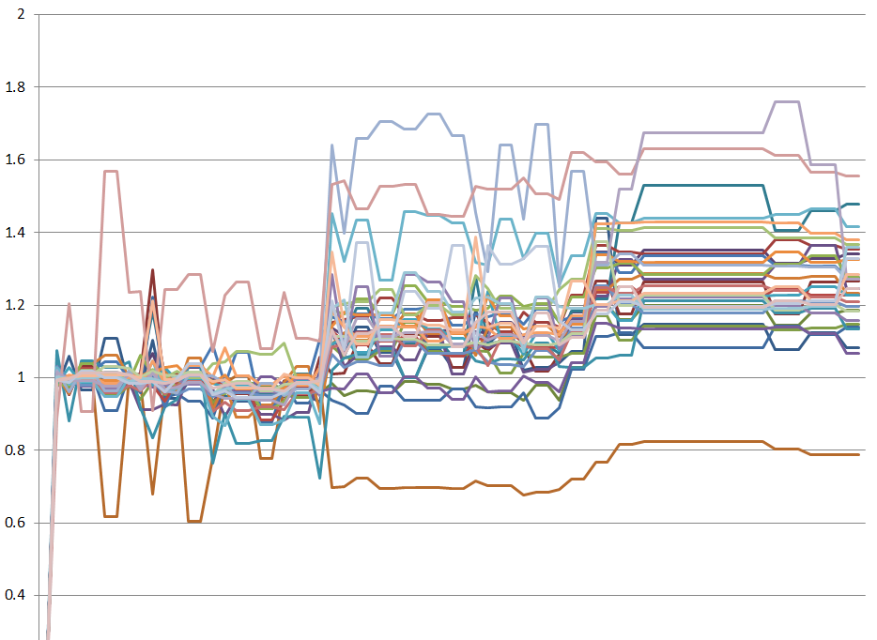
Examples
Identify change in test times

Slide 17
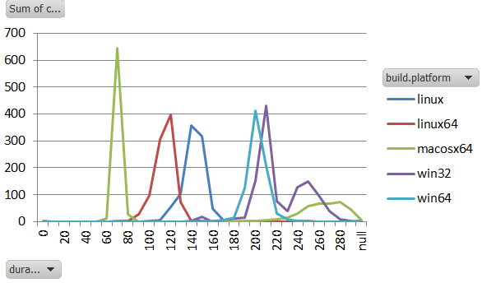
Examples
Identify change in test times
Test-time distributions

Slide 18
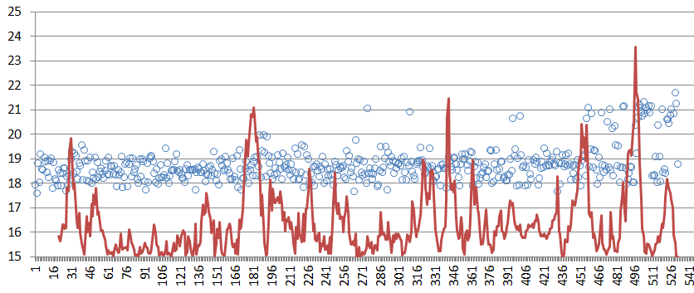
Examples
Identify change in test times
Test time distributions
Visualize perf regression

Slide 19
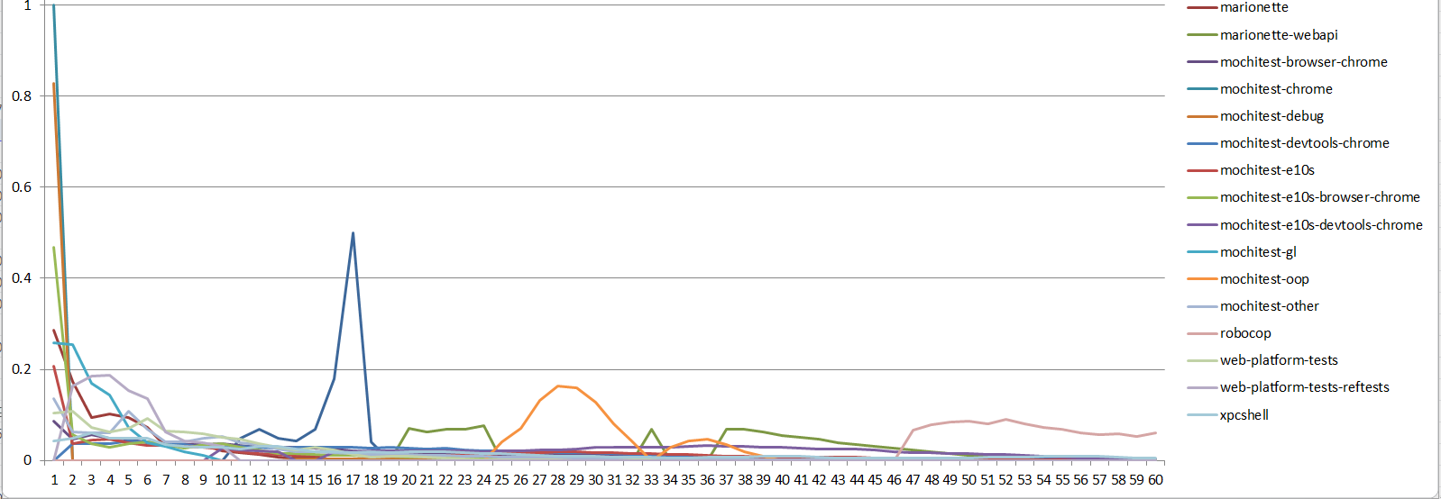
Examples
Identify change in test times
Test time distributions
Visualize perf regression
Fail rate by time into suite

Slide 20
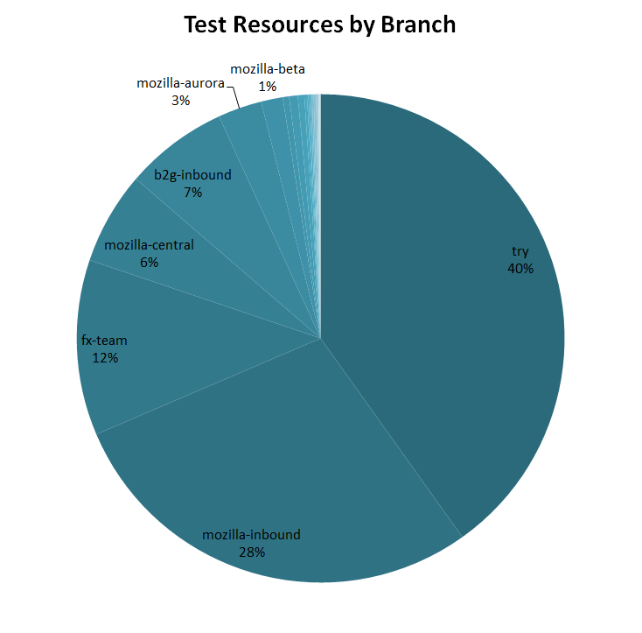
Examples
Identify change in test times
Test time distributions
Visualize perf regression
Fail rate by time into suite
CPU time by Branch

Slide 21
Active Data
http://activedata.allizom.org
  Kyle Lahnakoski
  Engineering Productivity

